Slide 1
SOFTWARE ARCHITECTURE AND DESIGN
SENG 307
Module 1- Week 3
Context of Software Architecture and Design

Slide 2
Context of Software Architecture
A proper view of software architecture affects every aspect of the classical software engineering activities:
Requirements
Design
Implementation
Analysis and Testing
Evolution
Development Process

Slide 3
Requirement Analysis and Specification
The most important phase of software development and should not be omitted under any condition
Major problem of software defects is due to wrong specifications
The result of this phase is the software requirements specifications document (SRS) that serves as the starting point for the next phase of software development, namely, software design
SRS: Focuses only on what the software system should do and not on how it should be done; that is, implementation details are not allowed to affect this phase.
Once requirements have been captured, they are analyzed for determining priorities, dependencies, versions, schedule formation, staff size determination, project cost estimation, and analyzing nonfunctional requirements.
After analysis, the requirements are modeled using unified modeling language diagrams, entity-relationship diagrams, data flow diagrams, or formal methods.

Slide 4
Software Requirement Analysis
Elicitation
Identification
Documentation
Verification
Validation
Prioritization
Notes:
Requirement Elicitation: This is the initial stage where stakeholders, including clients, end-users, and domain experts, are consulted to gather information about the software's purpose, features, and constraints. Various techniques such as interviews, surveys, and workshops are used to elicit requirements.
Requirement Identification: During this step, the collected information is analyzed to identify different types of requirements. These can be categorized into functional requirements (what the system must do) and non-functional requirements (how the system should perform).
Requirement Documentation: Requirements are documented in a clear and structured manner. Common documentation formats include requirement documents, use cases, user stories, and requirement traceability matrices.
Requirement Prioritization: Not all requirements are of equal importance. Stakeholders collaborate to prioritize requirements based on their criticality, business value, and dependencies. This helps in making informed decisions about what to implement first.
Requirement Validation: Validation involves ensuring that the requirements are complete, consistent, and realistic. It often requires validation sessions with stakeholders to clarify ambiguities and resolve conflicts.
Requirement Verification: Verification confirms that the requirements align with the business objectives and can be traced back to the original needs. This step may involve reviews and inspections.
Change Management: Requirements may change over time due to evolving business needs or other factors. A change management process should be in place to handle and document changes.
Note: software requirement validation focuses on the correctness of the requirements in terms of addressing the stakeholders' needs, while requirement verification focuses on the quality of the documented requirements, ensuring they are complete, consistent, and adhere to predefined standards.

Slide 5
Software Requirement Specification
Requirements specification is the process of writing down the user and system requirements in a requirements document.
the user and system requirements should be clear, unambiguous, easy to understand, complete, and consistent.
The user requirements for a system should describe the functional and non-functional requirements so that they are understandable by system users who don’t have detailed technical knowledge.
Ideally, they should specify only the external behavior of the system. The requirements document should not include details of the system architecture or design
System requirements are expanded versions of the user requirements that are used by software engineers as the starting point for the system design.

Slide 6
Requirement Specification Constituents
Requirement Documentation: The finalized and validated requirements are documented in a detailed specification document. Typically includes both functional and non-functional requirements, as well as any relevant diagrams, and prototypes.
Functional Requirements: what the software must do in terms of features, behaviors, and interactions.
Non-Functional Requirements: system's quality attributes, such as performance, scalability, security, usability, and reliability. They set expectations for how the system should perform and behave.
User Interface (UI) Design: The specification may include UI design guidelines, wireframes, or mockups to describe the look and feel of the user interface.
Data Requirements: Information about data structures, storage, and database requirements should be included when relevant.
Testing Requirements: Specifications for testing the software, including test cases, test scenarios, and acceptance criteria, are documented to ensure that the system meets its requirements.
Notes:
In summary, requirement analysis is the initial phase focused on understanding and gathering preliminary requirements, often in an informal and flexible manner. Requirement specification follows, formalizing and documenting these requirements into a structured and precise document.

Slide 7
Requirement Specification Constituents
Traceability: Requirement traceability matrices link each requirement back to its source and forward to its implementation and testing. This helps ensure that all requirements are met.
Sign-off: Once the specification is complete and reviewed, stakeholders, including clients and development teams, may sign off on the document to indicate their agreement with the stated requirements
Notes:
In summary, requirement analysis is the initial phase focused on understanding and gathering preliminary requirements, often in an informal and flexible manner. Requirement specification follows, formalizing and documenting these requirements into a structured and precise document.

Slide 8
Importance of Requirement Specification
Clarity and Shared Understanding
Basis for Development
Scope Control
Quality Assurance
Documentation
Communication
Legal and Regulatory Compliance
Risk Mitigation
Notes:
Clarity and Shared Understanding: The SRS provides a clear and unambiguous description of the software's functionality and requirements, ensuring that all stakeholders share a common understanding.
Basis for Development: It serves as the foundation for software design, development, and testing. Developers rely on the SRS to build the software according to the specified requirements.
Scope Control: The SRS document helps manage the scope of the project by clearly defining what is included and what is not, reducing the likelihood of scope creep.
Quality Assurance: By specifying testing requirements and acceptance criteria, the SRS assists in quality assurance and helps ensure that the software meets its intended quality standards.
Documentation: The SRS document provides a comprehensive reference for project documentation and helps in maintaining a record of requirements, design decisions, and changes.
Communication: It facilitates effective communication among project stakeholders, including developers, testers, project managers, and clients, ensuring everyone is on the same page.
Legal and Regulatory Compliance: The SRS helps ensure that the software complies with legal and regulatory requirements, which is crucial for certain industries.
Risk Mitigation: It helps identify potential risks and uncertainties early in the project, allowing teams to develop strategies for mitigating these risks.

Slide 9
Traditional Requirements Analysis
Traditional SE suggests requirements analysis should remain unsullied by any consideration for a design
However, without reference to existing architectures it becomes difficult to assess practicality, schedules, or costs
In building architecture we talk about specific rooms…
…rather than the abstract concept “means for providing shelter”
In engineering new products come from the observation of existing solution and their limitations

Slide 10
New Perspective on Requirements Analysis
Existing designs and architectures provide the solution vocabulary
Our understanding of what works now, and how it works, affects our wants and perceived needs
The insights from our experiences with existing systems
helps us imagine what might work and
enables us to assess development time and costs
→ Requirements analysis and consideration of design must be pursued at the same time

Slide 11
Non-Functional Properties (NFP)
NFPs are the result of architectural choices
NFP questions are raised as the result of architectural choices
Specification of NFP might require an architectural framework to even enable their statement
An architectural framework will be required for assessment of whether the properties are achievable

Slide 12
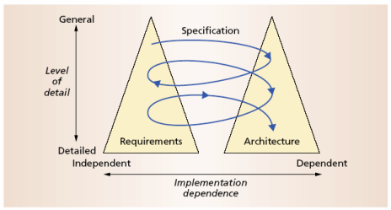
The Twin Peaks Model

Slide 13
Software Design vs Architecture
Software Design | Software Architecture
Software design is about designing individual modules/components. | Software architecture is about the complete architecture of the overall system.
Software design defines the detailed properties. | Software architecture defines the fundamental properties.
It is considered as one initial phase of Software Development Cycle (SSDLC) and it gives detailed idea to developers to implement consistent software. | It is a plan which constrains software design to avoid known mistakes and it achieves one organizations business and technology strategy.
In one word the level of software design is implementation. | In one word the level of software architecture is structure.
How we are building is software design. | What we are building is software architecture.

Slide 14
Software Design vs Architecture
 | Software Architecture | Software Design
Focus | deals with high-level structural concerns and the organization of a system as a whole | deals with low-level details and the internal structure of individual components, classes, or modules.
Scope | defines the overall structure of the software system, including its major components or modules, their relationships, and how they interact | focuses on the specific implementation of each component, specifying how they will function and interact internally.
Abstraction | provides a high-level abstraction of the system, emphasizing concepts like components, interfaces, and system-wide decisions | involves a lower-level of abstraction, detailing algorithms, data structures, and class interactions.
Decisions | decisions are typically global in nature and have far-reaching implications for the entire system. | decisions are local and pertain to individual components or modules. They do not have the same global impact as architectural decisions.
Requirements | aligns with the system's non-functional requirements (e.g., scalability, performance, reliability) and ensures they are met | aligns with the system's functional requirements, defining how the software will perform its intended tasks.

Slide 15
Design and Architecture
Design is an activity that pervades software development
It is an activity that creates part of a system’s architecture
Typically in the traditional Design Phase decisions concern
A system’s structure
Identification of its primary components
Their interconnections
Architecture denotes the set of principal design decisions about a system
That is more than just structure

Slide 16
Software Architecture & Software Engineering Activities : Architecture-Centric Design
Traditional design phase suggests translating the requirements into algorithms, so a programmer can implement them
Architecture-centric design
stakeholder issues
decision about use of COTS component
overarching style and structure
package and primary class structure
deployment issues
post implementation/deployment issues

Slide 17
Design Techniques
Basic conceptual tools
Separation of concerns
Abstraction
Modularity
Two illustrative widely adapted strategies
Object-oriented design
Domain-specific software architectures (DSSA)

Slide 18
Object-Oriented Design (OOD)
Objects
Main abstraction entity in OOD
Encapsulations of state with functions for accessing and manipulating that state

Slide 19
Pros and Cons of OOD`
Pros
UML modeling notation
Design patterns
Cons
Provides only
One level of encapsulation (the object)
One notion of interface
One type of explicit connector (procedure call)
Even message passing is realized via procedure calls
OO programming language might dictate important design decisions
OOD assumes a shared address space

Slide 20
Domain-Specific Software Architectures - DSSA
Capturing and characterizing the best solutions and best practices from past projects within a domain
Production of new applications can focus on the points of novel variation
Reuse applicable parts of the architecture and implementation
Applicable for product lines
→Recall the Philips Koala example discussed in the previous lecture

Slide 21
Software Architecture & Software Engineering Activities : Implementation
The objective is to create machine-executable source code
That code should be faithful to the architecture
Alternatively, it may adapt the architecture
How much adaptation is allowed?
Architecturally-relevant vs. -unimportant adaptations
It must fully develop all outstanding details of the application

Slide 22
SA & SE Activities: Faithful Implementation
All of the structural elements found in the architecture are implemented in the source code
Source code must not utilize major new computational elements that have no corresponding elements in the architecture
Source code must not contain new connections between architectural elements that are not found in the architecture
Is this realistic? Overly constraining? What if we deviate from this?

Slide 23
Unfaithful Implementation
The implementation does have an architecture
It is latent, as opposed to what is documented.
Failure to recognize the distinction between planned and implemented architecture
robs one of the ability to reason about the application’s architecture in the future
misleads all stakeholders regarding what they believe they have as opposed to what they really have
makes any development or evolution strategy that is based on the documented (but inaccurate) architecture doomed to failure

Slide 24
Implementation Strategies
Generative techniques
e.g. parser generators
Frameworks
collections of source code with identified places where the engineer must “fill in the blanks”
Middleware
CORBA, DCOM, RPC, …
Reuse-based techniques
COTS, open-source, in-house
Writing all code manually

Slide 25
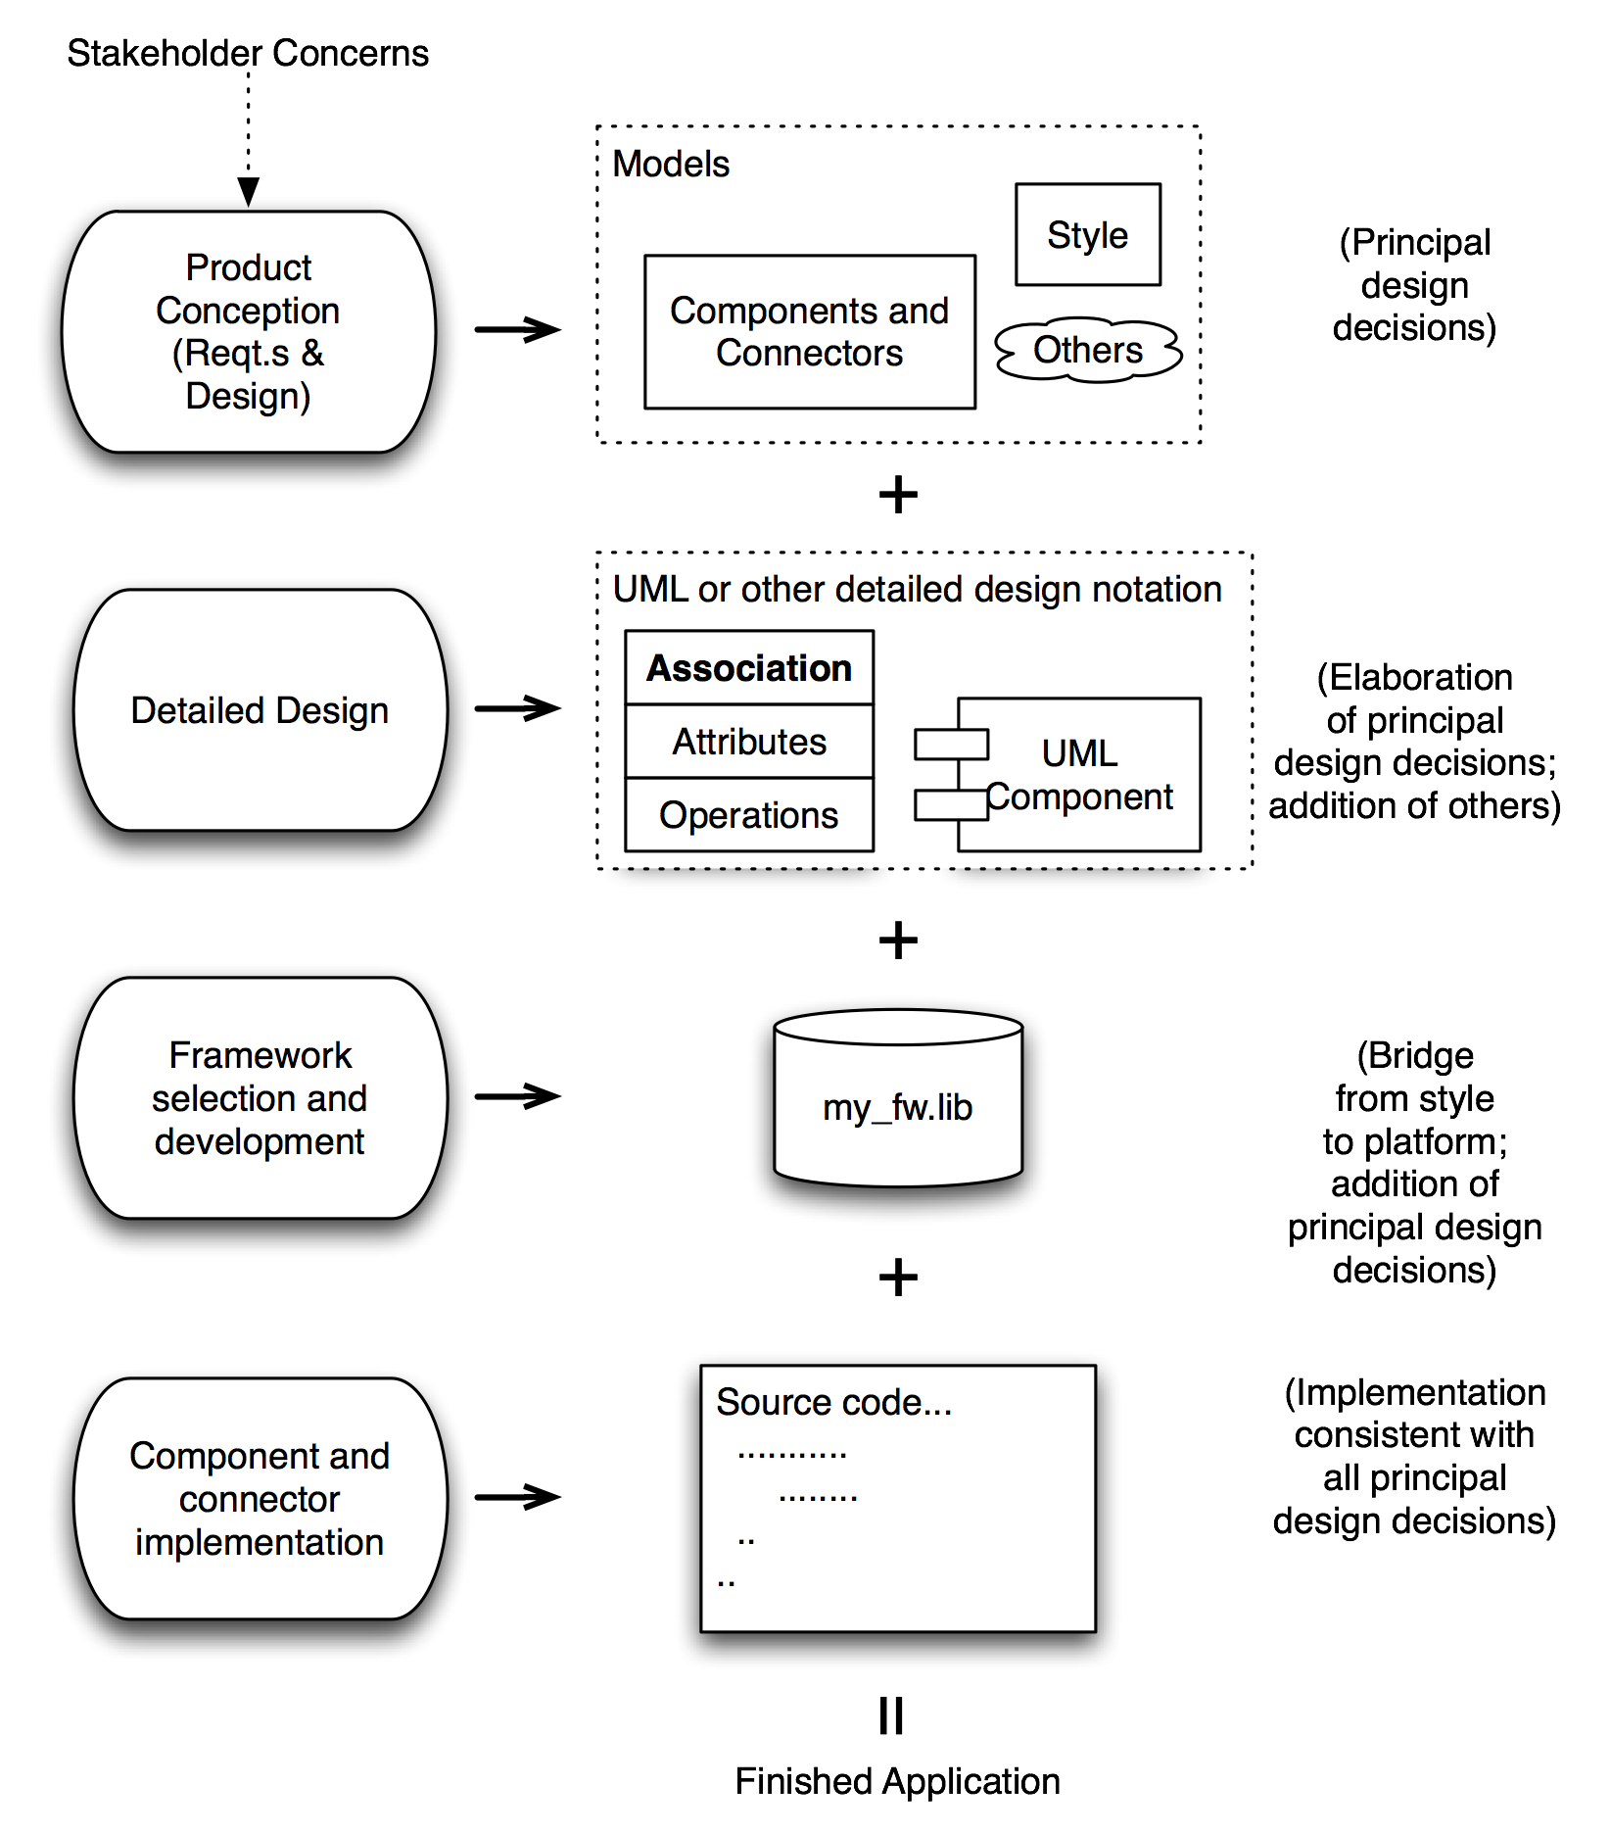
How It All Fits Together
Software Architecture: Foundations, Theory, and Practice; Richard N. Taylor, Nenad Medvidovic, and Eric M. Dashofy; © 2008 John Wiley & Sons, Inc. Reprinted with permission.

Slide 26
Analysis and Testing
Analysis and testing are activities undertaken to assess the qualities of an artifact
The earlier an error is detected and corrected the lower the aggregate cost
Rigorous representations are required for analysis, so precise questions can be asked and answered

Slide 27
An Architecture Model
An architecture model is a partial abstraction of a system.
It is an approximation, and it captures the different properties of the system.
It is a scaled-down version and is built with all the essential details of the system.

Slide 28
Analysis of Architectural Models
Analysis of Architectural Models
Architecture analys is defined as the activity of discovering important system properties using the system's architectural models.
Formal architectural model can be examined for:
Internal consistency,
Consistency with requirements and
Correctness

Slide 29
Ways to Defining Software Architecture
UML (Unified Modeling Language) − UML is one of object-oriented solutions used in software modeling and design.
Architecture View Model (4+1 view model) − Architecture view model represents the functional and non-functional requirements of software application.
ADL (Architecture Description Language) − ADL defines the software architecture formally and semantically.

Slide 30
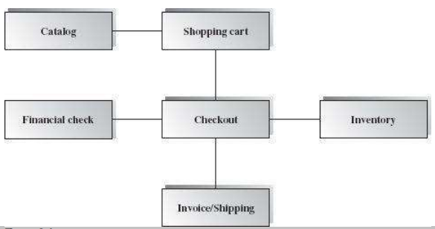
Example of a Model
Box-and-line diagram

Slide 31
Analysis of Architectural Models (cont’d)
An analysis on a formal model can reveal
Component mismatch
Incomplete specifications
Undesired communication patterns
Deadlocks
Security flaws
It can be used for size and development time estimations

Slide 32
Evolution and Maintenance
All activities that chronologically follow the release of an application
Software will evolve
Regardless of whether one is using an architecture-centric development process or not
The traditional software engineering approach to maintenance is largely ad hoc
Risk of architectural decay and overall quality degradation
Architecture-centric approach
Sustained focus on an explicit, substantive, modifiable, faithful architectural model

Slide 33
Architecture-Centric Evolution Process
Motivation
Evaluation or assessment
Design and choice of approach
Action
includes preparation for the next round of adaptation

Slide 34
Processes
Traditional software process discussions make the process activities the focal point
In architecture-centric software engineering the product becomes the focal point
No single “right” software process for architecture-centric software engineering exists

Slide 35
Context of Software Architecture and Design
Technical: What technical role does the software architecture play in the system or systems of which it’s a part?
Project life cycle: How does a software architecture relate to the other phases of a software development life cycle?
Business: How does the presence of a software architecture affect an organization’s business environment?
Professional: What is the role of a software architect in an organization or a development project?

Slide 36
Technical Context
The most important technical context factor is the set of quality attributes that the architecture can help to achieve.
The architecture’s current technical environment is also an important factor.
Standard industry practices
Software engineering techniques prevalent in the architect’s professional community.
Today’s information systems are web-based, object-oriented, service-oriented, mobility-aware, cloud-based, social-networking-friendly.
It wasn’t always so.
It won’t be so ten years from now.

Slide 37
Project Life-Cycle Context
Software development processes are standard approaches for developing software systems.
They impose a discipline on software engineers and, more important, teams of software engineers.
They tell the members of the team what to do next.
There are four dominant software development processes:
Waterfall
Iterative
Agile
Model-driven development

Slide 38
Architecture Activities
All of these processes include design among their obligations.
Architecture is a special kind of design, so architecture finds a home in each one.
No matter the software development process, there are activities involved in creating a software architecture, using that architecture to realize a complete design, and then implementing or managing the evolution of a target system or application:
1. Making a business case for the system
2. Understanding the architecturally significant requirements
3. Creating or selecting the architecture
4. Documenting and communicating the architecture
5. Analyzing or evaluating the architecture
6. Implementing and testing the system based on the architecture
7. Ensuring that the implementation conforms to the architecture

Slide 39
Business Context
Architectures and systems are not constructed frivolously.
They serve some business purposes.
These purposes may change over time.

Slide 40
Architecture and Business Goals
Systems are created to satisfy the business goals of one or more organizations.
Development organizations want to make a profit, or capture market, or stay in business, or help their customers do their jobs better, or keep their staff gainfully employed, or make their stockholders happy, or a little bit of each.
Customers have their own goals for acquiring a system, usually involving some aspect of making their lives easier or more productive. Other organizations involved in a project’s life cycle, such as subcontractors or government regulatory agencies, have their own goals dealing with the system.
Architects need to understand who the vested organizations are and what their goals are. Many of these goals will have a profound influence on the architecture.

Slide 41
Architecture and Business Goals
Every quality attribute
—such as a user-visible response time or platform flexibility or ironclad
security or any of a dozen other needs
—should originate from some higher purpose that can be described in
terms of added value.
“Why do you want this system to have a really fast response time?”
This differentiate the product from its competition and let the developing organization capture market share.
Some business goals will not show up in the form of requirements.
Still other business goals have no effect on the architecture whatsoever.
A business goal to lower costs might be realized by asking employees to work from home, or turn the office thermostats down in the winter, or using less paper in the printers.

Slide 42
Professional Context
You will perform many duties beyond directly producing an architecture.
You will need to be involved in supporting management and dealing with customers.
Architects need more than just technical skills.
Architects need to explain to one stakeholder or another the chosen priorities of different properties, and why particular stakeholders are not having all of their expectations fulfilled.
Architects need diplomatic, negotiation, and communication skills.
Architects need the ability to communicate ideas clearly
You will need to manage a diverse workload and be able to switch contexts frequently.
You will need to be a leader in the eyes of developers and management.
Architects need up-to-date knowledge.
You will need to know about (for example) patterns, or database platforms, or web services standards.
You will need to know business considerations.

Slide 43
Stakeholders
A stakeholder is anyone who has a stake in the success of the system
Stakeholders typically have different specific concerns that they wish the system to guarantee or optimize.
You will need to know and understand the nature, source, and priority of constraints on the project as early as possible. Therefore, you must identify and actively engage the stakeholders to solicit their needs and expectations.
Early engagement of stakeholders allows you to understand the constraints of the task, manage expectations, negotiate priorities, and make tradeoffs.

Slide 44
Stakeholders Know your stakeholders!
Talk to them, engage them, listen to them, and put yourself in their shoes.
See Table 3.1 ( in the reference textbook)for a list of example stakeholders and their interests and concerns.

Slide 45
How is Architecture Influenced?
Requirements influence the architecture, of course.
But the requirements specification only begins to tell the story.
A software architecture is a result of business and social influences, as well as technical ones.
The existence of an architecture in turn affects the technical, business, and social environments that subsequently influence future architectures.
In particular, each of the contexts for architecture plays a role in influencing an architect and the architecture.

Slide 46
What Do Architectures Influence?: Technical context
The architecture can affect stakeholder requirements for the next system
It gives the customer the opportunity to receive a system (based on the same architecture) in a more reliable, timely, and economical manner than if built from scratch.
A customer may in fact be willing to relax some of their requirements to gain these economies.
Shrinkwrapped software has clearly affected people’s requirements by providing solutions that are not tailored to any individual’s precise needs but are instead inexpensive and (in the best of all possible worlds) of high quality.

Slide 47
What Do Architectures Influence? Project context
The architecture affects the structure of the developing organization.
An architecture prescribes the units of software that must be implemented (or otherwise obtained) and integrated to form the system.
These units are the basis for the development project’s structure.
Teams are formed for individual software units; and the development, test, and integration activities all revolve around the units.
Teams become embedded in the organization’s structure.

Slide 48
What Do Architectures Influence? Business context
The architecture can affect the business goals of the developing organization.
A successful system built from an architecture can enable a company to establish a foothold in a particular market segment.
The architecture can provide opportunities for the efficient production and deployment of similar systems, and the organization may adjust its goals to take advantage of its newfound expertise to plumb the market.

Slide 49
What Do Architectures Influence? Professional context
The process of system building will affect the architect’s experience with subsequent.
A system that was successfully built around a particular technical approach will make the architect more inclined to build systems using the same approach in the future.
Architectures that fail are less likely to be chosen for future projects.

Slide 50
Summary
Architectures exist in four different contexts
Technical:The technical context includes the achievement of quality attribute requirements.
Project life cycle: Regardless of the software development methodology you use, you must perform specific activities.
Business: The system created from the architecture must satisfy the business goals of a wide variety of stakeholders.
Professional: You must have certain skills and knowledge to be an architect, and there are certain duties that you must perform as an architect.
An architecture has influences that lead to its creation, and its existence has an impact on the architect, the organization, and, potentially, the industry.

Slide 51
Summary
A proper view of software architecture affects every aspect of the classical software engineering activities
The requirements activity is a co-equal partner with design activities
The design activity is enriched by techniques that exploit knowledge gained in previous product developments
The implementation activity
is centered on creating a faithful implementation of the architecture
utilizes a variety of techniques to achieve this in a cost-effective manner

Slide 52
Summary
Analysis and testing activities can be focused on and guided by the architecture
Evolution activities revolve around the product’s architecture.
An equal focus on process and product results from a proper understanding of the role of software architecture

